Slide 1
Portfolio Prioritization Workshop
Cost of Delay Introduction

Slide 2
We need to do...
Sequence and value the project work using Cost of Delay within groups
Consolidate and calibrate work across groups
Understand constraints to sequencing work in “optimal” order
Dependencies, Experts, Types of teams
Achieve these outcomes and stay friends

Slide 3
Today’s Agenda (2 hours)
20 mins | Introduction, outcomes and expectations
Phase One - Key Lessons about Prioritization and Cost of Delay
40 mins | Introduction to Prioritization using Cost of Delay
Phase Two - Group Categorization and Prioritization
30 mins | The prioritization template and facilitation, and doing an example categorization
Phase Three - Quantification of Cost of Delay where necessary
15 mins | How to quantify cost of delay and profiles discussion
Wrap up and Next Steps
5 mins | Next steps
10 mins | Questions and concerns

Slide 4
Prioritization & Cost of Delay Key Lessons
Phase One

Slide 5
Prioritization needs us to
Shift from the
Value of doing
to
Impact of delay

Slide 6


The problem with any prioritization decision is [it is a] decision to service one job and delay another.
Don Reinertsen
Suggested Reading: Principles of Product Development Flow

Slide 7
K E Y T A K E A W A Y # 1
“You can ignore ECONOMICS, but it won’t ignore you…”

Slide 8
Economics
The study of choice (allocation of resources (time/money/people/tools)) under conditions of scarcity and uncertainty.
Notes:
Robert Hall, Marc Lieberman

Slide 9
Why determine start order?
constraint(s)
Demand
>
Available
Capacity
Cash, people, equipment or time (most often it’s time)

Slide 10

Group Question | Your ordering constraints
(10 minutes)
As a group, discuss what are the constraints that force ordering work:
Money - we can’t fund everything
Expert Skills - we have a skill constraint; What skills? (consider the skill exercise)
External Dependencies - we depend on another team. (consider dependency exercise)
Others ….
Q. What or who causes reordering of work?
Q. If we were to say, start them in random order, what would the objections be?

Slide 11

K E Y T A K E A W A Y # 2
It’s NOT just highest value (dollars), it is how best to align flow through constraint(s)
Yoda: constraints cause delay; delay leads to suffering

Slide 12



Playing Tetris | Work, Teams/Skills and Time
Today: Lots of gaps. We get it done, but not everyone is happy
Simple heuristics and rules. Simple Cost of Delay computations
Theoretical - perfect; NOT our goal
Work: spans multiple teams with varying effort
Delivered value (time)
Teams / people and skills

Slide 13
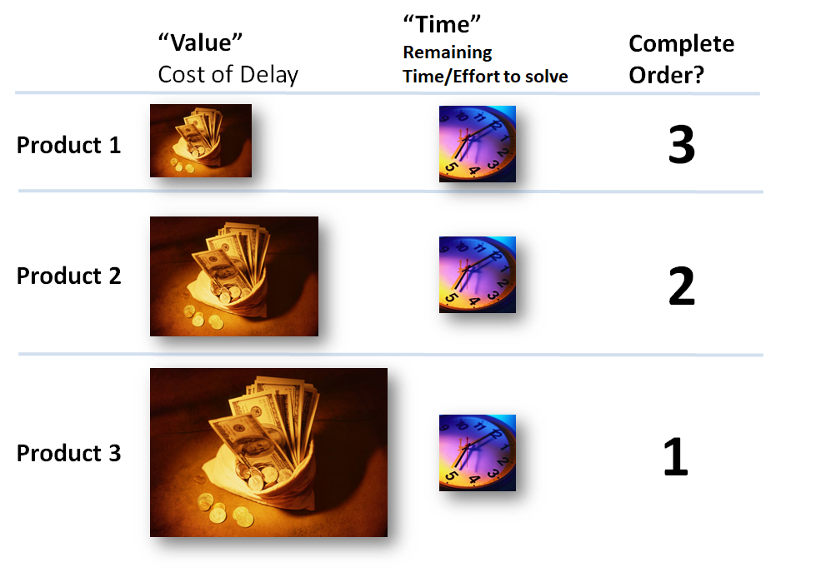
Intuitive Order | Same “Time” Different “Value”

Slide 14
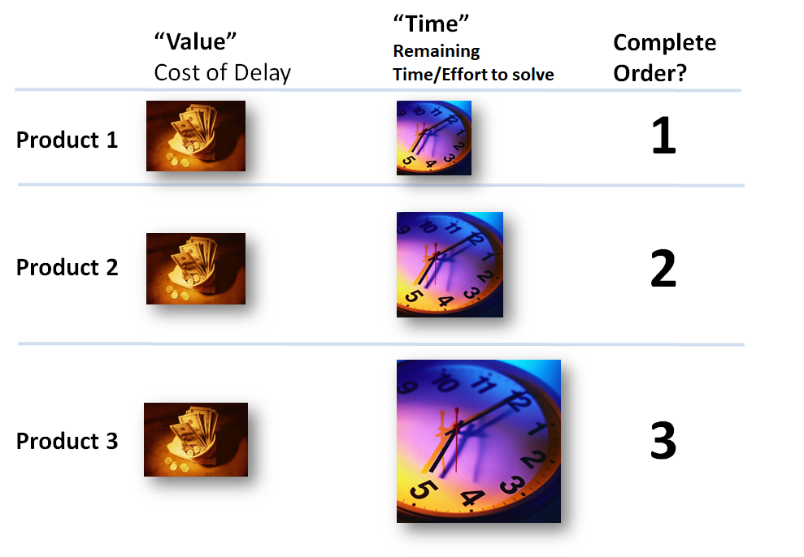
Intuitive Order | Same “Value” Different “Time”

Slide 15
The Goal
What to start next?
Given a set of things we could do next, is one more economically advantageous to start next given we can’t do them ALL immediately?
The Problem
Work often competes for the same people/constraint
Some items have MASSIVE reward if delivered sooner (items A)
Some items have MINIMAL reward if delivered sooner (items B)
Basic rule: DON’T delay items A for items B!
The Challenge
Doing one thing delays others
Every item has a different economic impact by being delayed.
The impact will be a product of lost value, and how long they are delayed.
Basic rule: If A and B have similar reward, Do the SHORTEST first

Slide 16
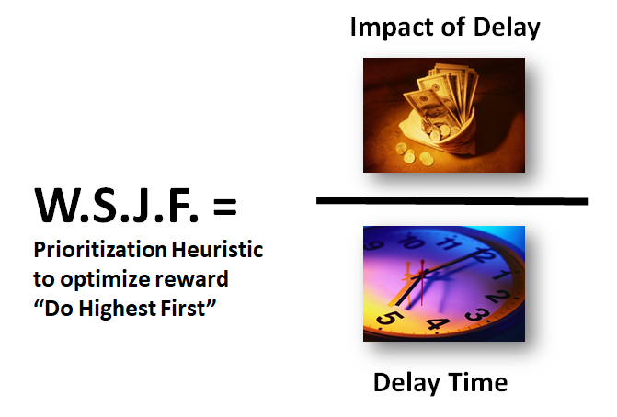
Ordering Heuristic | Weighted Shortest Job First

Slide 17
“CD3” | The Comparable Price Tag of Time
Urgency
Value of Information Discovery
Benefits ($)
COST OF DELAY
Prioritise features by
Note: “CD3” picks a standard duration unit, often a week making comparisons easier
DURATION

Slide 18
CD3: COST OF DELAY DIVIDED BY DURATION
How value decays over time
Business value of the feature
Information discover value
COST OF DELAY
W.S.J.F. SCORE =
DURATION
FEATURE | DURATION | COST OF DELAY | Score
A | 5 | $1 | 0.2
B | 1 | $4 | 4
C | 2 | $5 | 2.5

Slide 19
K E Y T A K E A W A Y # 3
You need to consider “value” lost for each item if delayed, this is the basic heuristic for economic ordering

Slide 20
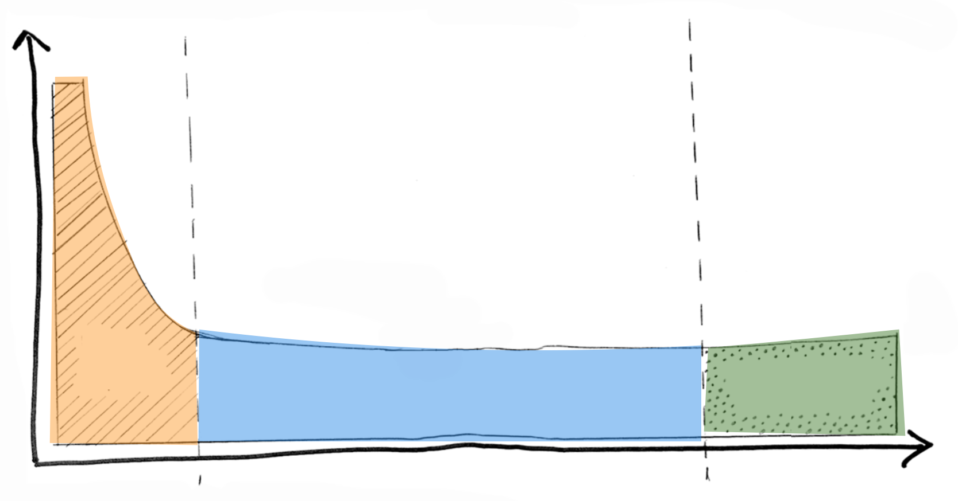
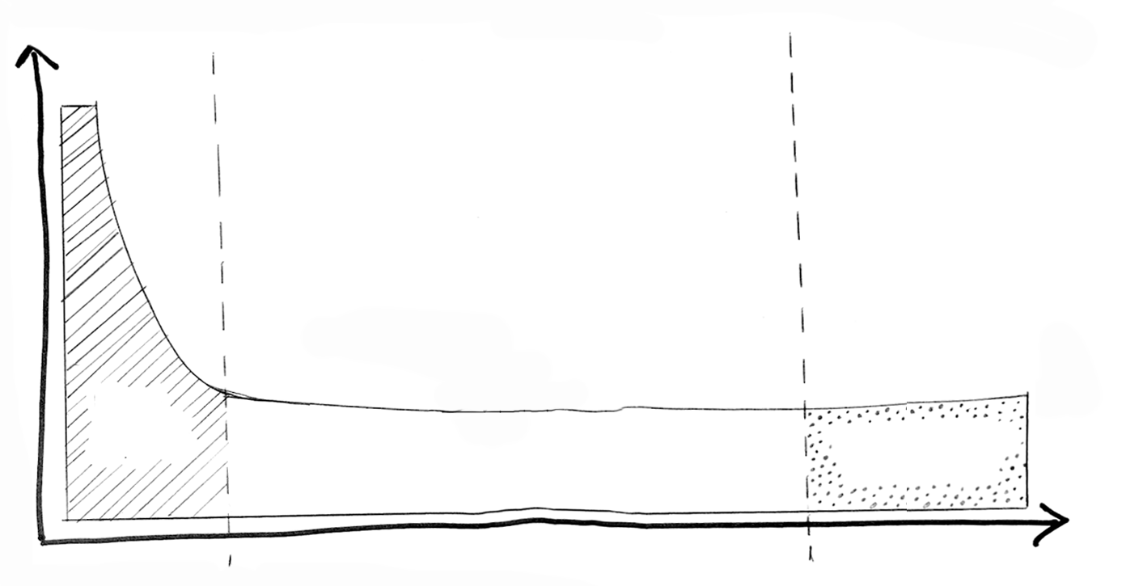
Cost of Delay / Duration
Tip: Do these first, or have a good reason not to
~5%
Tip: Give the teams “simple rules” to apply policy. E.g. “We will round-robin work from team A, B and C teams in this ratio...”
~15%
Delay Cost / Week
Noisy Tail
High Delay Cost
Hmmmm…
(muddy middle)
Deferrable without impact
Number “Backlog” items

Slide 21
K E Y T A K E A W A Y # 4
Don’t miss HUGE cost of delay items
Don’t argue about the muddy middle

Slide 22
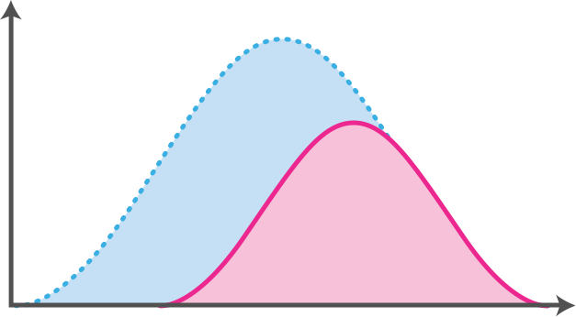
SHORT LIFE-CYCLE: PEAK AFFECTED BY DELAY
1: Short benefits horizon, and reduced peak due to late delivery
REDUCED PEAK
$ BENEFITS / WEEK
DELAY COST
LATE ENTRY
TIME

Slide 23
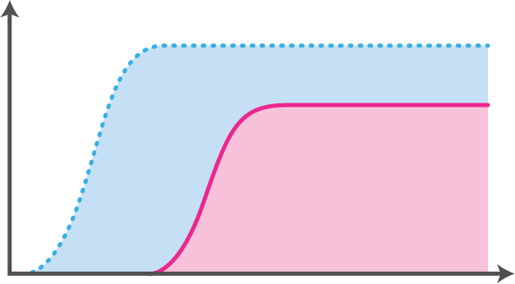
LONG LIFE-CYCLE: PEAK AFFECTED BY DELAY
2: Ideas with very long life, with reduced peak due to later delivery
REDUCED PEAK
$ BENEFITS / WEEK
DELAY COST
LATE ENTRY
TIME

Slide 24
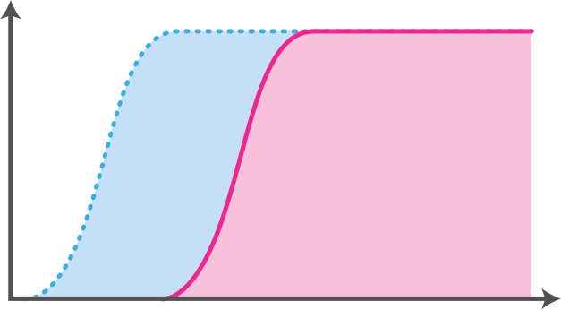
IMPACTED BY EXTERNAL DEADLINE
3: Ideas with a “long life,” with a peak unaffected by delay
$ BENEFITS / WEEK
DELAY COST
LATE ENTRY
TIME
BEYOND LAST RESPONSIBLE MOMENT

Slide 25
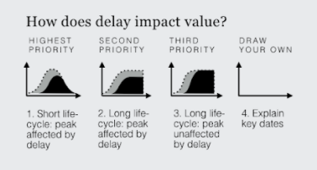
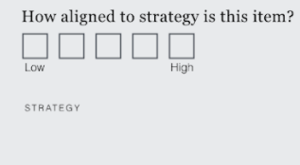
K E Y T A K E A W A Y # 5
If Items Have Similar Cost of Delay Use Urgency and Strategic Alignment as Tiebreakers

Slide 26
Group Categorization and Prioritization
Phase Two

Slide 27
Group Prioritization Template
We have produced a PowerPoint deck populated with your sector’s projects
We have taken the latest project data from the [where] spreadsheet
What we need
All work grouped into one of three buckets (lo-fidelity Cost of Delay)
Work within the Gold and Blue bucket ordered by approximate Cost of Delay
Work in the first THIRD of the blue bucket quantitatively ordered by Cost of Delay
Let’s look at an example

Slide 28
Exercise | Triaging Example
Let’s learn how to triage an Emergency Room
Approximating Cost of Delay for ordering and grouping
Practice facilitation techniques

Slide 29
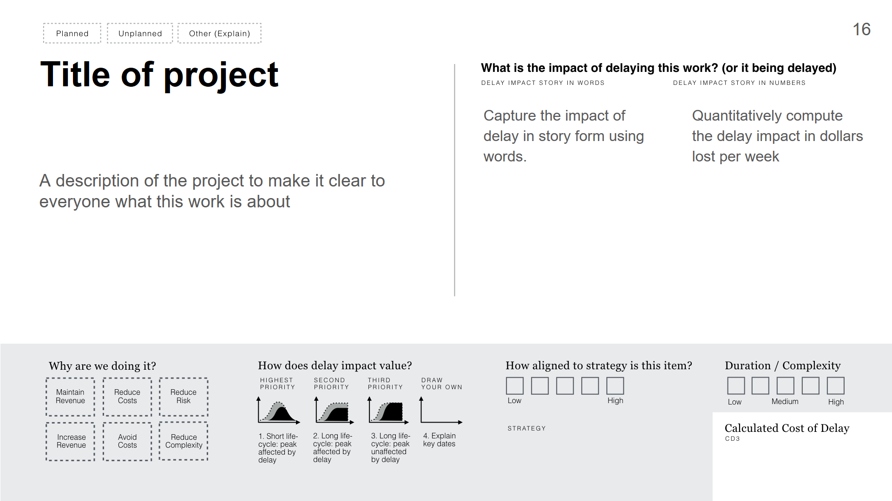

Slide 30

Exercise | Find likely most urgent & muddy middle
Goal: Reduce the number we need to do math on
(20 minutes)
As a group, identify work that is LIKELY in the most time sensitive buckets
Quickly read each proposed work item with someone giving a one sentence description
Poll with a thumbs up or down.
Majority up, then put into the “MOST URGENT - GOLD” with reason
Majority sideways, then put in the “UNSURE - DO THE MATH” group
Put it in the “MUDDY MIDDLE” group.
If anybody dissents, then write their name on it. They can analyse it offline
We think without math this is likely to be MOST URGENT
We aren’t sure, Let’s do the math!
We think this is in the “muddy middle” (it will get done, but not first)
Possibly a priority

Slide 31
Example | Simple Prioritization Rules
Start highest delay impact first
Similar delay impact? start the quickest to deliver first
Similar delay impact? start the most strategically aligned first
Similar delay impact? start the most perishable delay profile first
Work from multiple teams? round robin at an agreed ratio

Slide 32
Exercise | Simple Rules for Muddy Middle
(10 minutes)
As a group, define the simple rules for the “muddy middle”
The Muddy Middle

Slide 33
Quantification Where Necessary
Phase Three

Slide 35
& Feedback
Closing
How did we do?

Slide 36
Closing | Questions
What questions do you have?
What came up as we explored these topics?
What have you learned?

Slide 37

Closing | Feedback / Final Thoughts
How would you describe your experience during this workshop?
Any final thoughts?

Slide 38
Workshop
End of
Thank you

